Slide 1
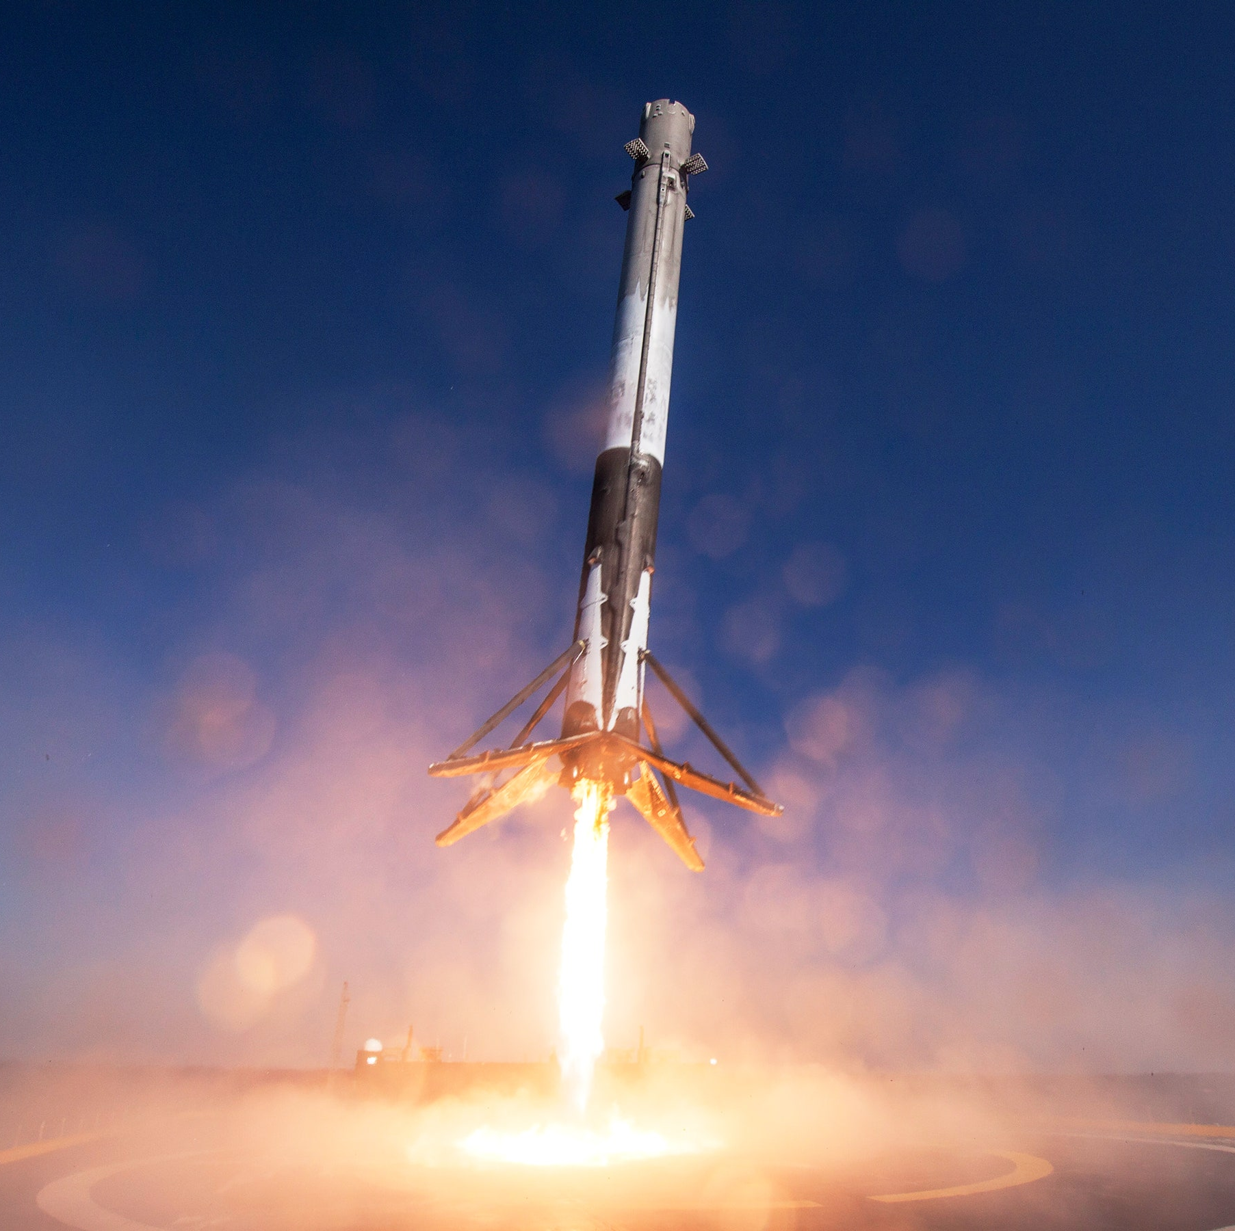
GDP Return 2023/2024
Team Leader : Sébastien Lambert
Team Members :
Patryk Chruśniak
Nicolas Lucotte
Dinesh Krishna Murthy
Nawaf Alarifi
Zhichen Zhou
Natalia Raquel Chacon Rios
MSc. Autonomous Vehicle Dynamics and Control
SpaceX photos –Falcon 9

Slide 2
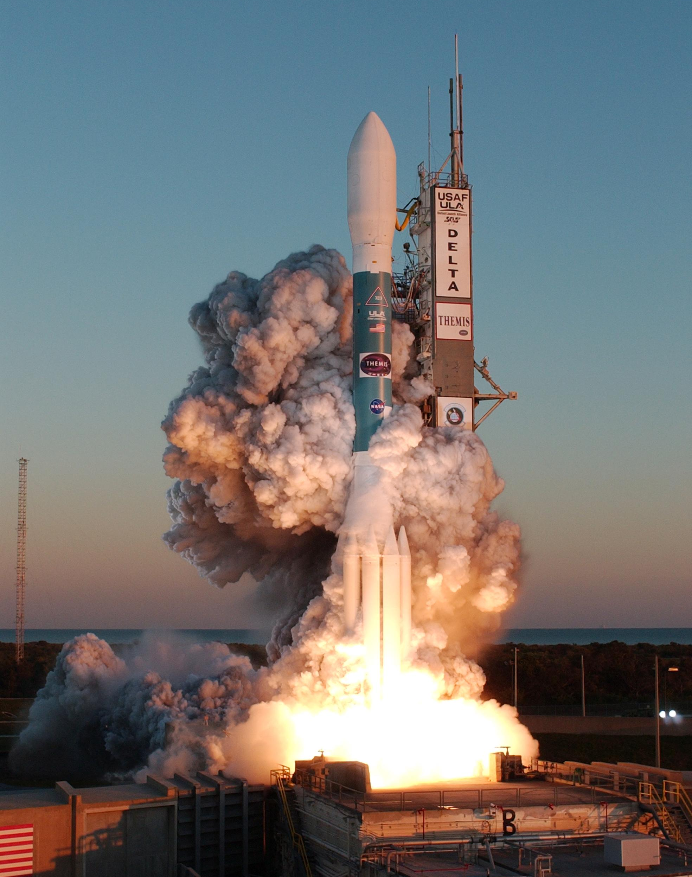
Table of contents
Teams
Aim and Objectives
Expanded objectives
Requirements
Selection, Design, and Verification of agents and payloads
Team propulsion
Team structure
Team control
Activity plan
Annex
Cette photo par Auteur inconnu est soumise à la licence CC BY-SA
Cette photo par Auteur inconnu est soumise à la licence CC BY-SA

Slide 3

Teams
Team Control:
Patryk Chruśniak
Nicolas Lucotte
Zhichen Zhou
Sébastien Lambert
Team Structure:
Nawaf Alarifi
Natalia Raquel Chacon Rios
Team Propulsion:
Dinesh Krishna Murthy

Slide 4
Aim and Objectives​
Main aim : Develop a test bed for testing GNC sensors and actuators, architectures and algorithms enabling vertical take-off and landing of launchers.​
Objectives :
-Pin-point landing in pre-selected – or not – target areas with and without the aid of GNSS
-Prototype with COTS components for a dynamically equivalent test platform to the most common vertical take-off and landing launching system

Slide 5

Detailed Objectives in steps
BASELINE SCENARIO
Pin-point landing with support of external positioning system
No improved pathing
Improved pathing
Pin-point landing without support of external positioning system
STRETCH SCENARIO​
Landing on movable landing site​
Don’t have marked scenario but the lander autonomously selects the favourable area to land​
Notes:
The external positioning system is always going to be connected for safety purposes

Slide 6
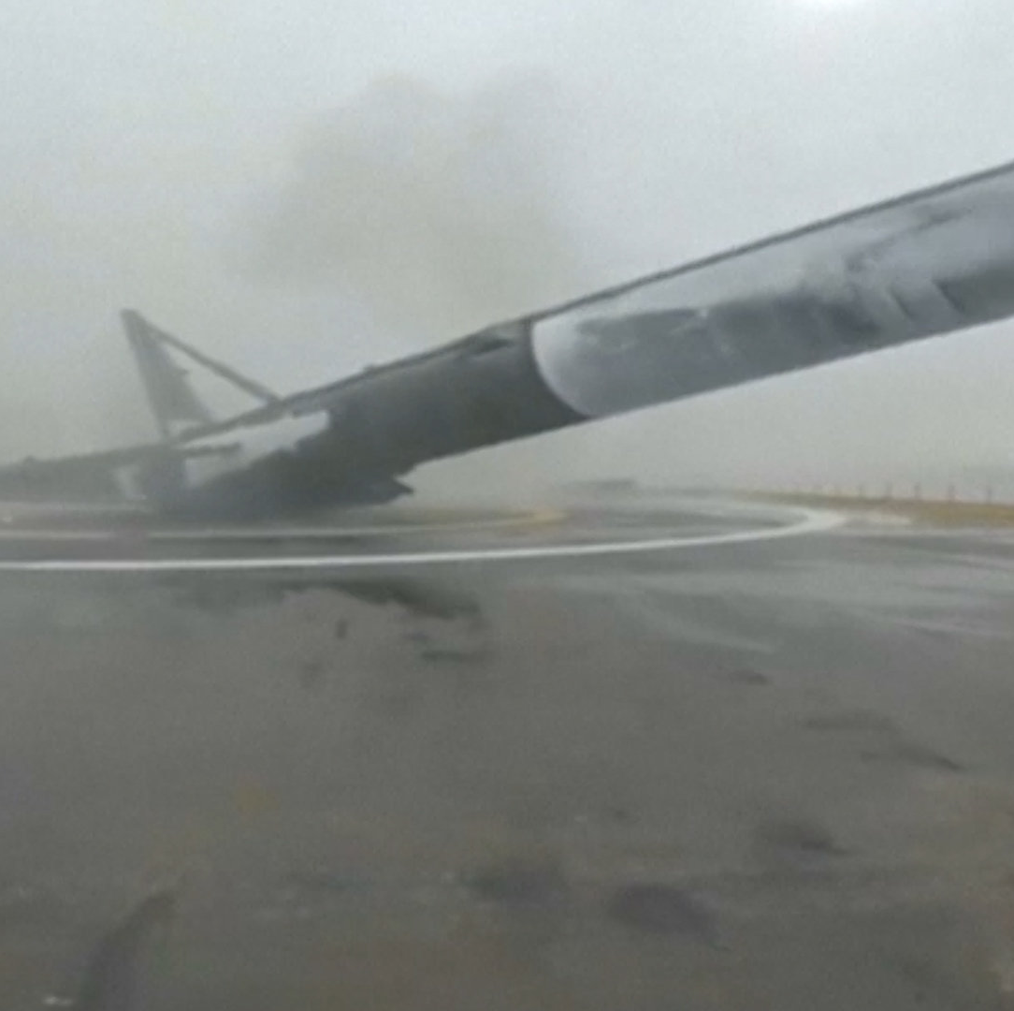
Expanded objectives
Landing with side wind in the landing area
Measuring the sloshing effect on landing

Slide 7

Requirements

Slide 8
Requirements
The prototype budget shall not exceed 2,000£
The prototype shall have similarities with existing rockets
Same Thrust-to-Weight-Ratio (TWR) [1]
Same CG to CT distance [2]
Same landing pad proportions
The prototype shall be fully controllable
The prototype shall have:
Structure mass limit: 4.5kg
Payload mass: 0.8kg
The prototype shall be safe and be reusable

Slide 9

Selection, Design, and Verification of agents and payloads

Slide 10

Active control position system
Thrust Vector Control (TVC)
Gimbaled Engines
Reaction Control System (RCS)

Slide 11
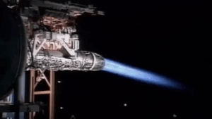
Thrust Vector Control (TVC)
Simplicity and Reliability
Manoeuvrability
Cost-Effectiveness
Ease of Integration
Versatility
Proven Technology
Allow to switch to plan B: drone

Slide 12
WHY servos for TVC
Accuracy
Reliability and Durability
High response speed

Slide 13
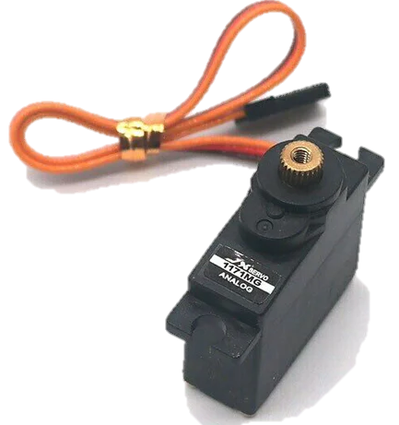
How servos control Thrust Vectoring
Achieve rapid and continuous adjustments
Using a ball join in between the rocket lander and nozzle for the movement of nozzle in horizontal and vertical direction
Receive control signal
Apply movement and force
Accurate positioning
Feedback control

Slide 14
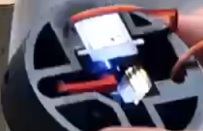
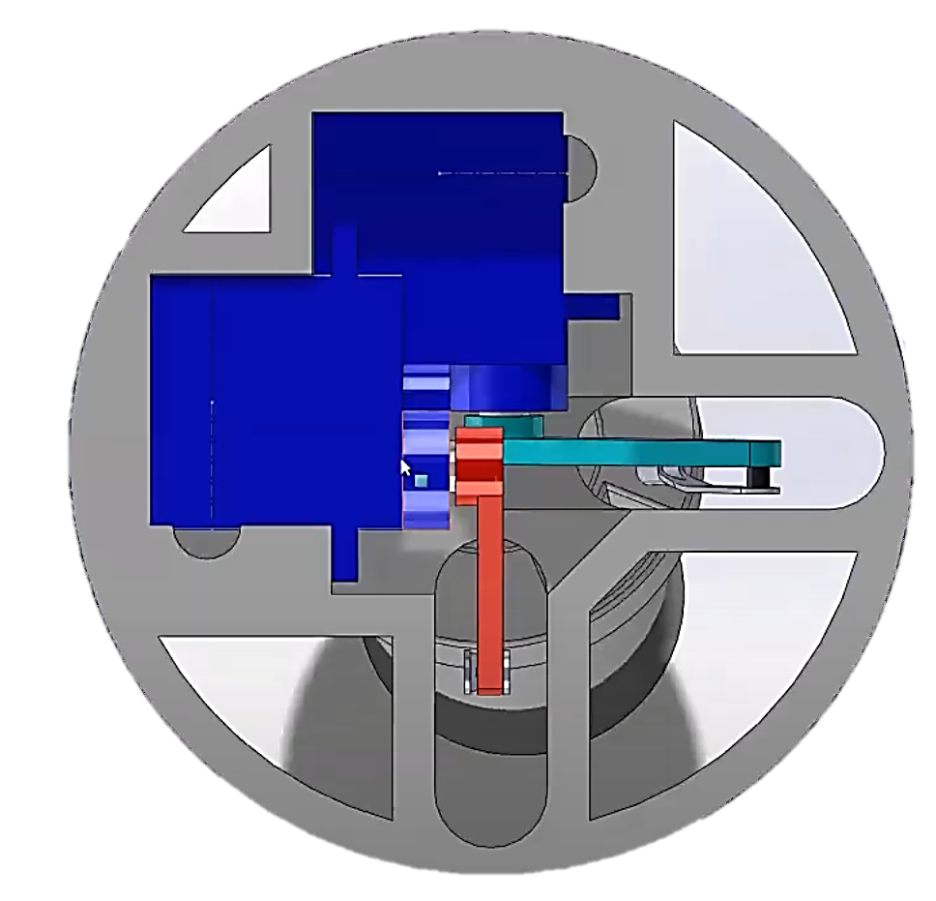
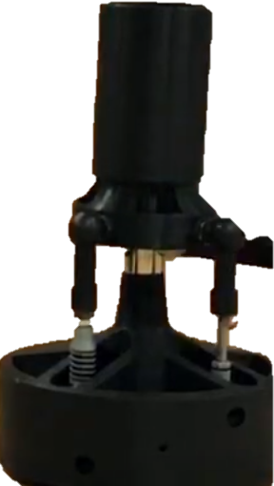
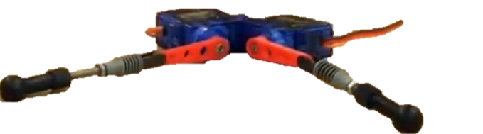
Thrust Vector Bracket and Setup
Servo horn positioned at 90°
for initial position
Servo mounted on the bracket
Servo horn connected
to the nozzle for thrust vectoring
Bracket
Servo’s mounting setup onto the bracket

Slide 15
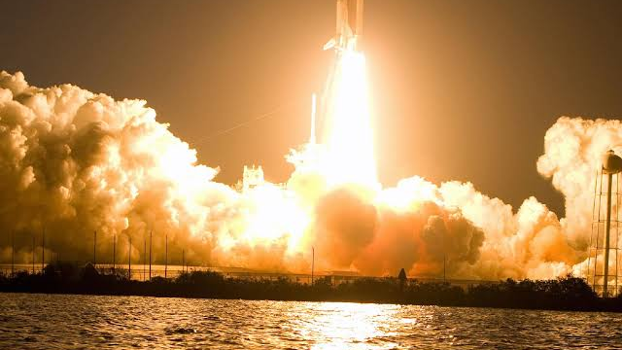
Team Propulsion

Slide 16
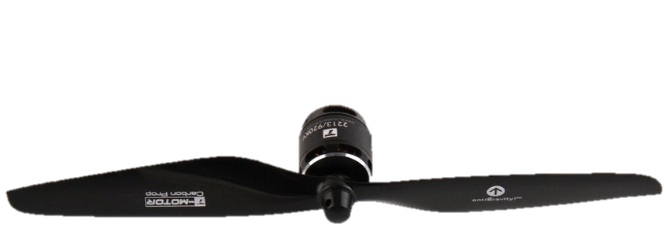
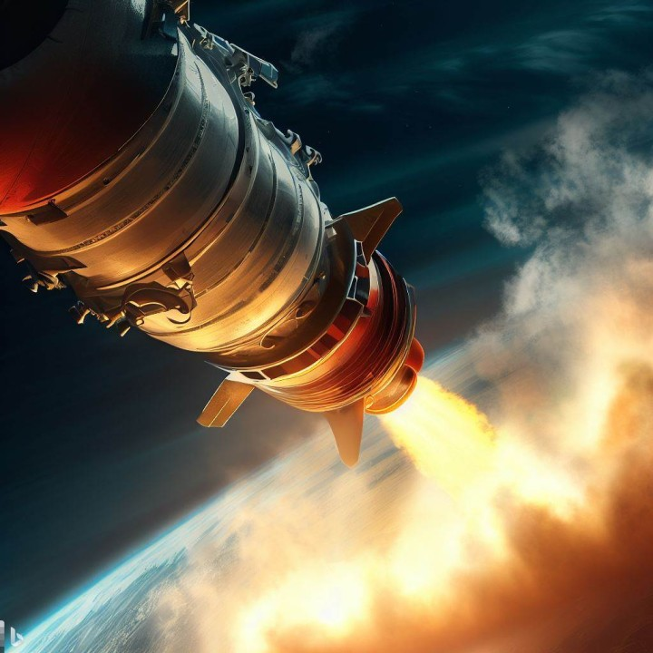
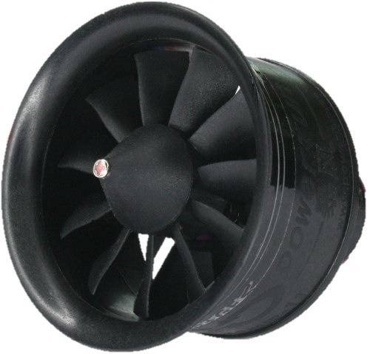
Propulsion System
Notes:
Tradeoff table analyzing EDF thrusters vs Propeller systems vs Propellant rockets for the Rocket lander

Slide 17
Requirements
Cost
Safety
Noise (Safety)
Thrust
Controllability
Reusability

Slide 18
Trade off table
System | Pros | Cons
Electric Ducted Fan (EDF) | Precise throttle control for stability Compact, high power density Low acoustic Signature Compact built and design Rapid throttle modulation creates instantaneous force response for tight trajectory corrections Vehicle remains powered for retrieval if anomalous touch down occurs Brushless outrunner motors enable high efficiency across wide operating range | Limited flight endurance from battery energy density Relatively lower max thrust capacity
Propellers | Simple, robust open-blade design Very high peak power for weigh | Poor controllability at low speeds near stall Exposed open blades hazardous near ground High acoustic noise pollution Prone to weather hazards like crosswinds upsetting stability near touchdown Difficult to generate lateral thrust for agile maneuvering, relies more on airframe and aerodynamic control surfaces
Propellant Rockets | Extremely high peak thrust Proven reliability in space applications | Low precision controllability Limited restart capability Risk of high velocity ground impact Highly explosive due to usage of propellants. (Safety Issue) Requires separate secondary propulsion system for final precision landing Significant ground infrastructure needed for safe ignition/testing of very high energy propellants Much more tightly regulated from a compliance, licensing, and public safety perspective Develop considerable less static thrust; requires long take-off runs on ground

Slide 19
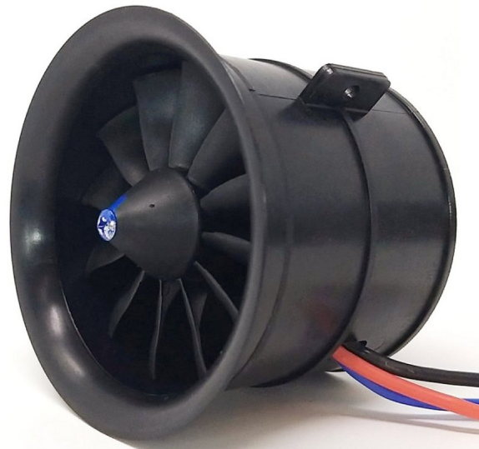
Propulsion System
Precise throttle
Compact, high power density
Low acoustic Signature
Compact built and design
Notes:
In summary, the ducted shroud and precise electric throttle control of EDF systems provide crucial flight precision and safety that open propellers cannot match at low altitudes. The electric ducted fans provide clean, quiet, thrust modulation in a redundant and compact architecture - delivering responsiveness, agility, and flexibility surpassing alternative propeller & rocket options to enable safe automated landings in constrained spaces.
And reusable EDFs offer greater landing versatility over single-burn rockets despite shorter mission durations per battery charge, which can be taken cared by the usage of high energy density batteries.

Slide 20
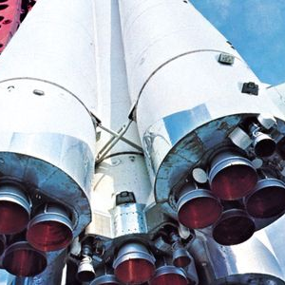
EDFs
Requirements
4 or 1 EDF ?
From the battery point of view
Notes:
3 and 2 do not allow control on all the axis.
4 EDF => backup solution + yaw control for spotting

Slide 21
1.Redundancy and Reliability
Functional requirements:
The thrust produced shall always allow a safety landing and failure shall not prevent from complete the mission
Implementation specification:
Failure of one EDF :
4 EDF still allows 75% remaining thrust capacity for safer recovery or emergency landing.
1 EDF lead to complete mission loss with single EDF failure.

Slide 22
2.Thrust Vectoring Control
Functional requirements:
The thrust vectoring control shall be precise in all three axis
Implementation specification:
Precise low-speed descent requires fine torque adjustments in pitch/roll/yaw. Minor differential power changes between the 4 EDFs allows full 3-axis agility. (Large single thruster relies on heavier and slower mechanical gimbal.)

Slide 23
Stability and Vibration Damping
Functional requirements:
The system shall be balanced and stable.
Implementation specification:
Balanced symmetrical layout resists induced oscillations versus central point mass. Provides tighter disturbance rejection essential for precision hovering and target touchdown.

Slide 24
Scalability for Different Payloads
Functional requirements:
The prototype shall lift the payload defined in the requirements and it shall have a similar thrust-to-weight ratio ≥ 2.2
Implementation specification:
Adding more modular EDF units extends payload capacity growth by reducing individual operating points. Single EDF already operating at peak rating leaves no overhead.

Slide 25
Why 4 EDF?
Thrust
Mass
Cost
Vibration/Stability
Redundancy

Slide 26
Why 4 EDF?
Parameter | 2 EDFs | 3 EDFs | 4 EDFs | 6 EDFs | 8 EDFs
Thrust per Unit | ≥ 4.5kg | ≥ 3kg | ≥ 2.25kg | ≥ 1.5kg | ≥ 1.125kg
Total Thrust | 9kg | 9kg | 9kg | 9kg | 9kg
Stability | Very deficient | Diminished | Excellent | Slightly higher | Large separation
Maneuverability | Ill-conditioned | Plane of rotation single axis spin | Fully actuated 3-axis vectoring | Additional fins required for yaw axis | Null axes require secondary effector
Structural Complexity | Simplest | Reasonable triangular frame | Quad symmetric mount | Additional arms/booms to distribute | Greatly increased mounting points
Hardware Cost | Lowest | Reasonable | Optimal balance | 50% higher component duplication | 2x cost per thruster
Vibration Dynamics | High imbalance risk | Some asymmetric modes | Tuned symmetric modes | Borderline re-appearance of asymmetric modes | Unbalanced vibration modes
Propulsive Efficiency | Intermittent operation | Reasonable match to efficient power curves | Avoids oversized units off peak | Improved matching to baseline design | Extremely small units harder to efficiently scale
Failure Tolerance | Loss of 1 unit = 50% capability remaining | Loss of 1 unit = 66% remaining | Loss of 1 unit = 75% remaining | Loss of 1 unit = 83% remaining | Loss of 1 unit = 87% remaining
2-3 EDFs fail to address critical stability and control needs. And increasing beyond 4 rapidly escalates design complications for minimal improvements. Hence, 4 EDFs satisfy key requirements optimally.
Notes:
Lift Capacity
Control Authority
Stability
Minimum Quantity
Landing Accuracy

Slide 27
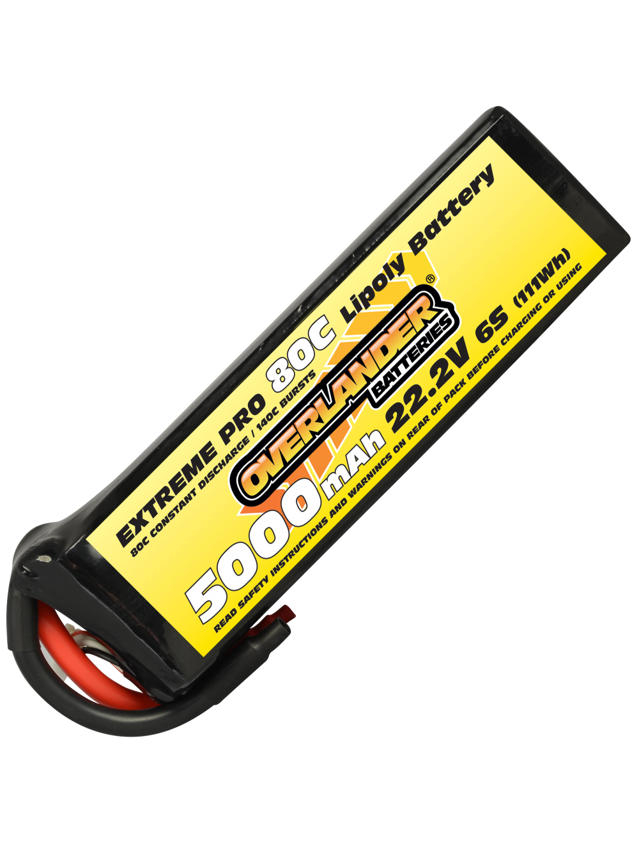
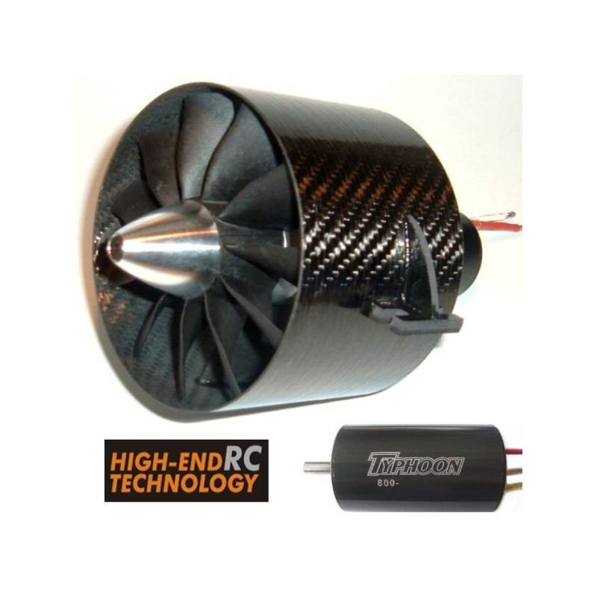
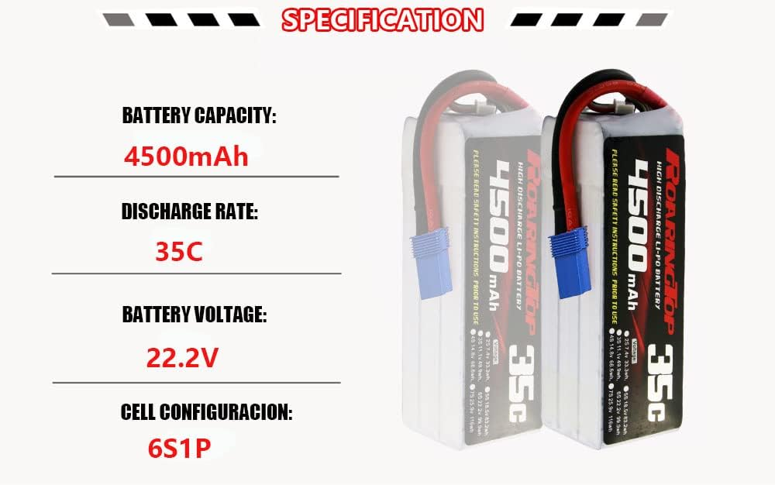
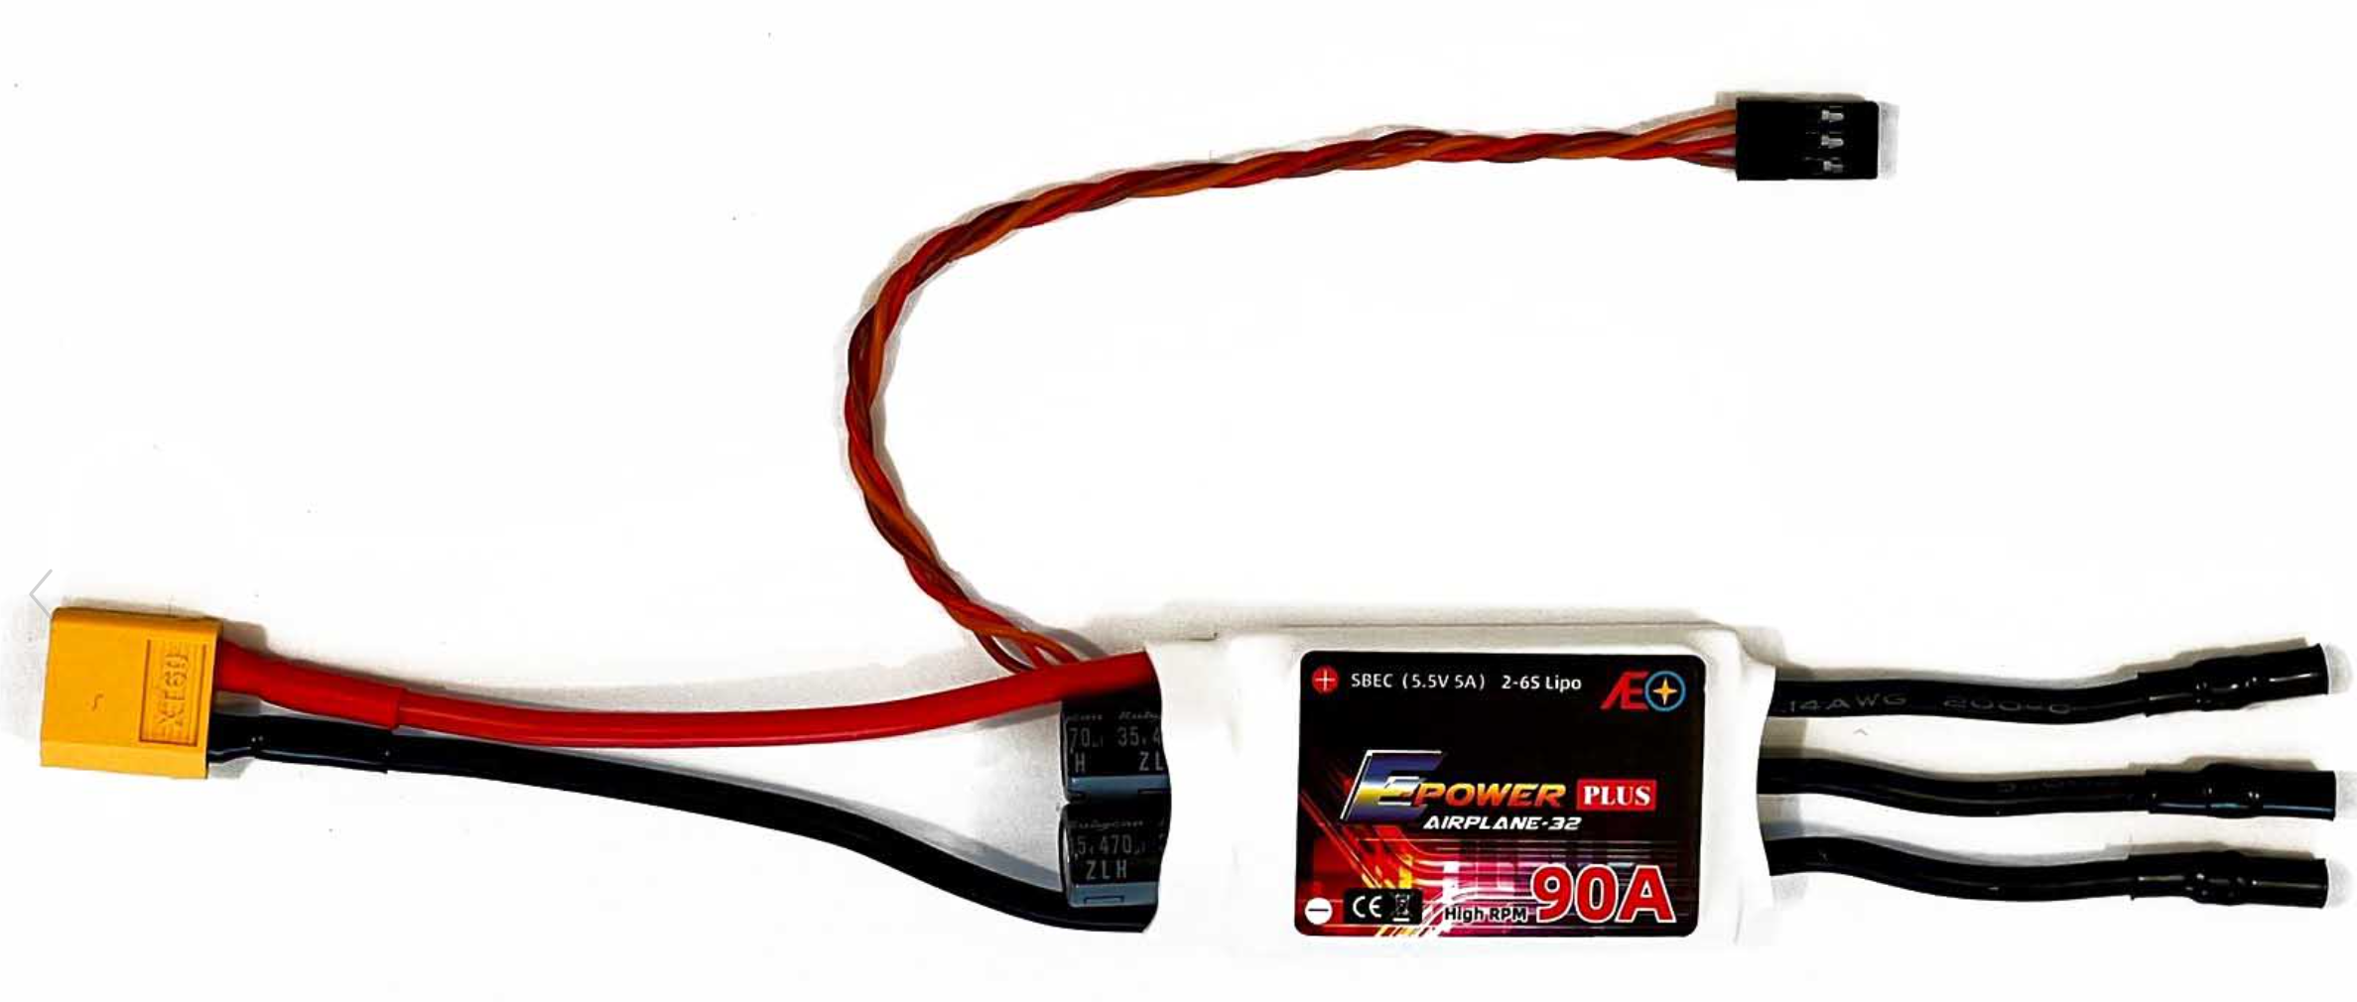
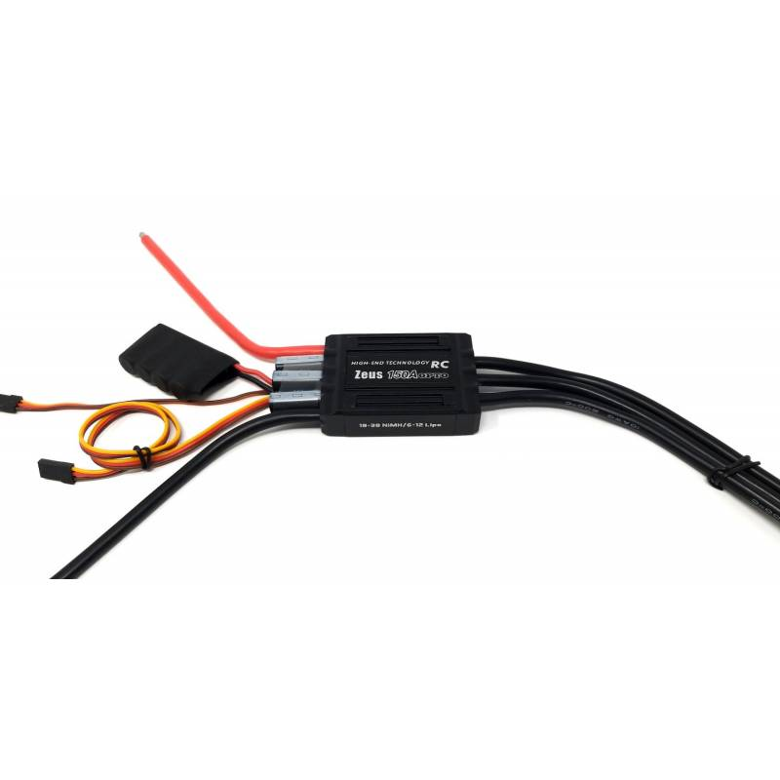
Components
4 EDF Setup
1 EDF Setup
5000mAh 80C 22.2V
590kV EDF
5000mAh 35C 22.2V
2100KV EDF
90A ESC
150A ESC

Slide 28
Final trade off EDF table
Parameter | 4 Smaller EDF Motors | 1 Larger EDF Motor
Total Thrust | 4 x 22.5N = 90N | 73.54N
Total Mass | 4 x 180g = 720g | 800g
Cost of EDF | 4 x £59.48 = £239 | $420 (larger units have economy of scale)
Redundancy | Loss of one motor leads to 25% reduced thrust | Complete mission failure if motor outage
Control Authority | Thrust vectoring by servo’s, by controlling the nozzle moment
Propulsive Efficiency | Optimized for peak efficiency zone of chosen motor curve | Potential off-peak operation for full thrust range
Mechanical Complexity | Simplified assembly x4 | More complex single mount
Vibration/ Stability | Symmetrical configuration aids stability with 2 X CW and 2 X CCW | Imbalance if single motor position offset
4 smaller EDF vs 1 larger EDF

Slide 29
Quad-EDF propulsion
£240 with connectors (4 x £59.48 )
90N (total thrust force 4 x 22.5N )
720g (4 x 180g)
Symmetrical configuration aids stability with 2 X CW and 2 X CCW

Slide 30
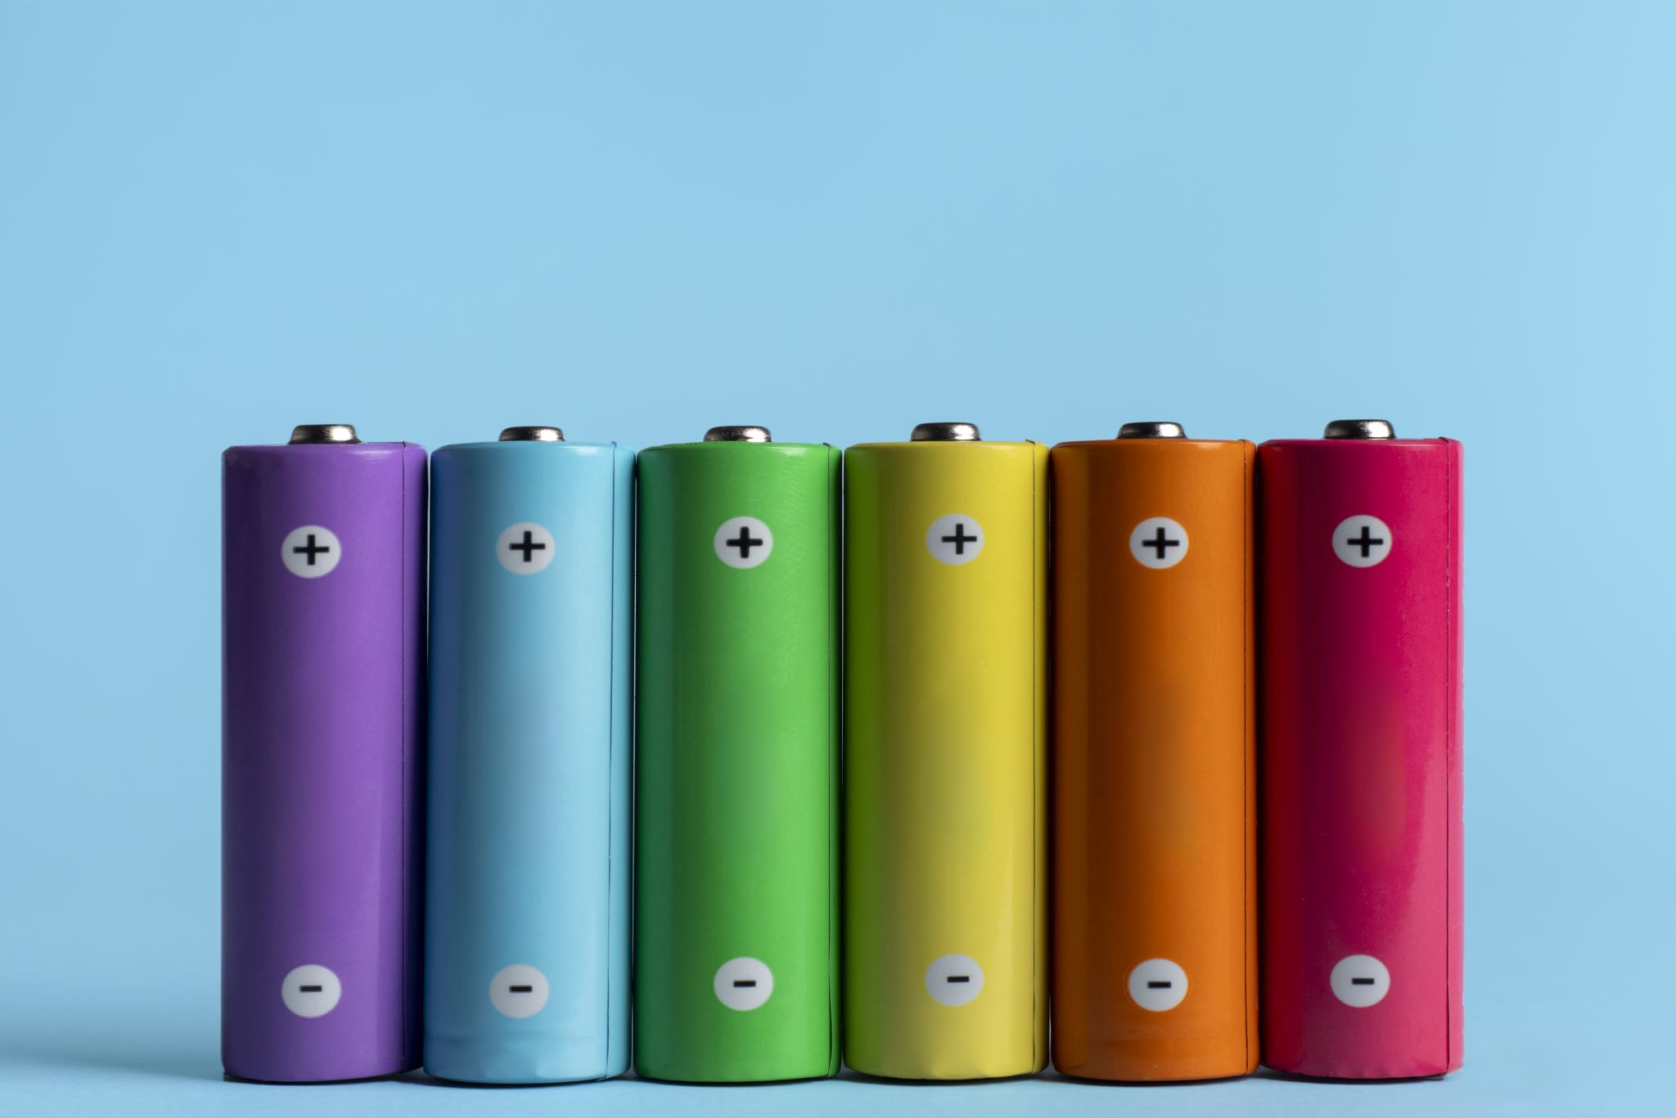
Quad-EDF propulsion - Batteries PoV
4 EDF Motors with 2 Batteries
Or
1 EDF Motor with 1 Battery

Slide 31
Batteries - Requirements
Total Energy Storage
Battery Voltage
Max Current, C Rating
Battery Mass

Slide 32
TRADE OFF TABLE
Parameter | 4 Small EDF Setup | 1 Large EDF Setup
Total Energy Storage | 2 x (5000mAh x 22.1V) = 222 Wh | 2 x (4500mAh x 22.2V) = 222 Wh
Battery Voltage | 22.1V (6S) | 44.4V (12S) parallel
Max Current, C Rating | 400A based on 80C rating | 175A based on 35C rating
Battery Mass | 2 x 0.82kg = 1.64kg | 2 x 0.6kg = 1.2kg
Flight time | 3 minutes 15 seconds flight time | 3 minutes 21 seconds flight time

Slide 33
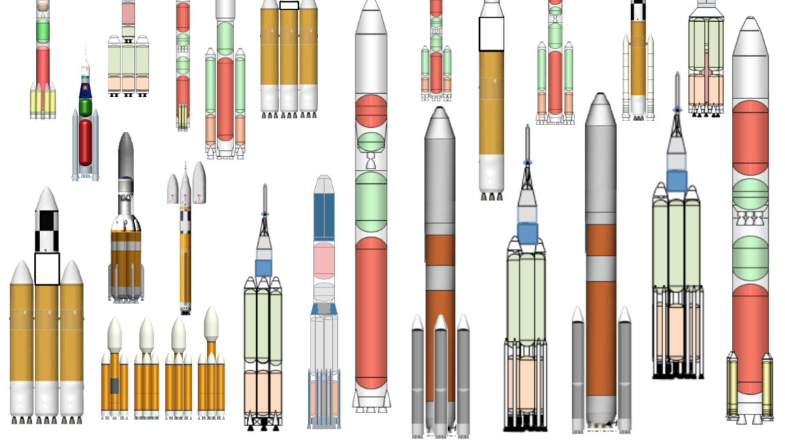
Team Structure

Slide 34
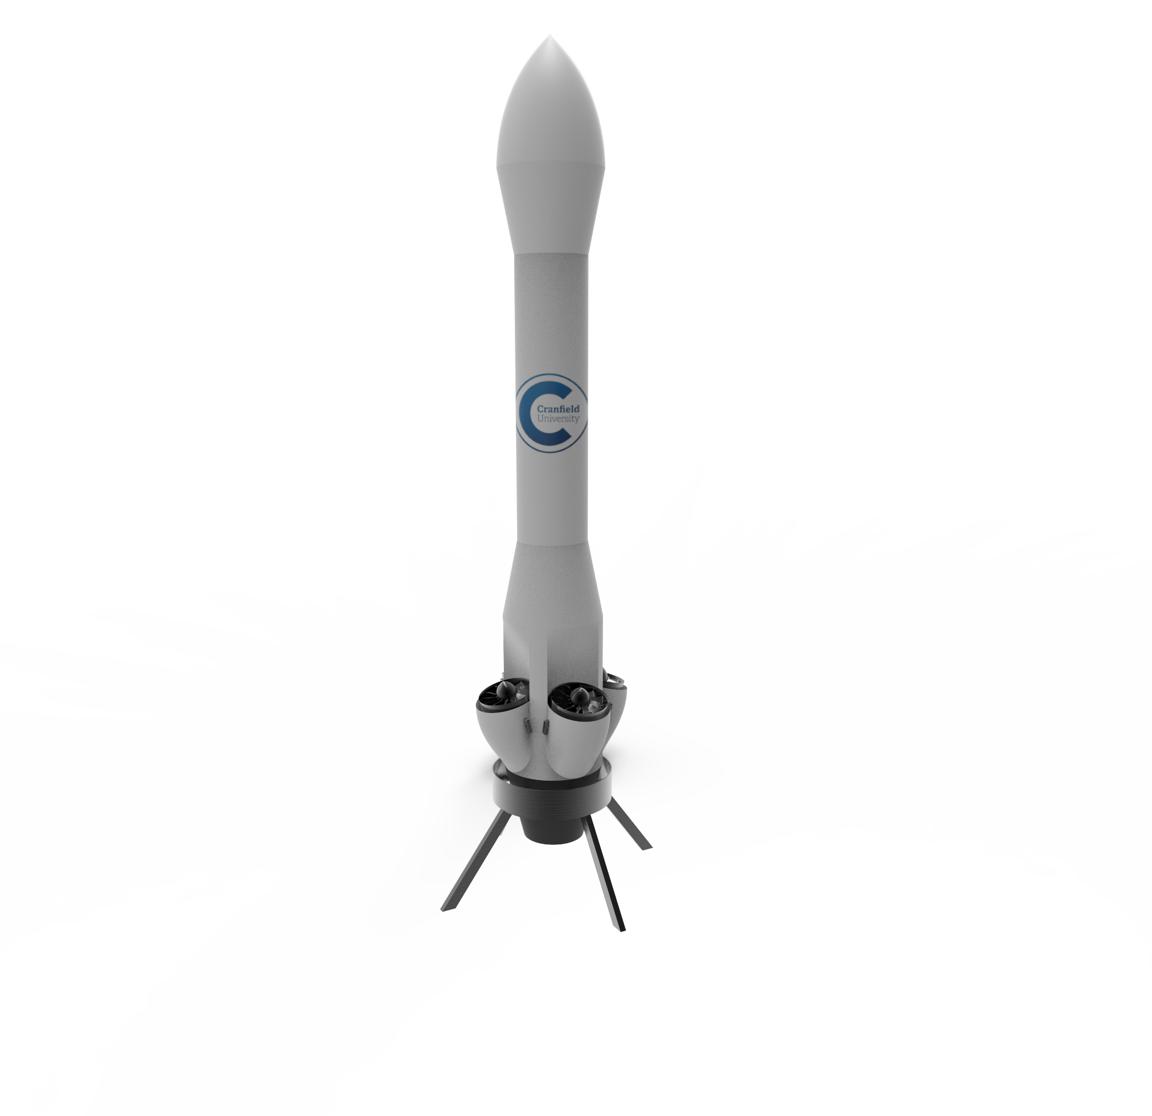
Selection, Design, and Verification of agents and payloads
- Similarity with an actual rocket design stability.
Fins for real application
EDFs inclination reason
The loses in the EDFs due to their inclination is impacting the overall design?

Slide 35
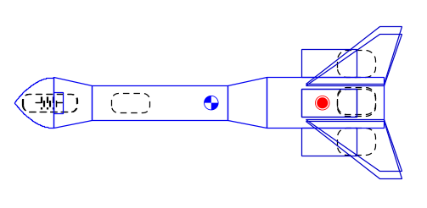
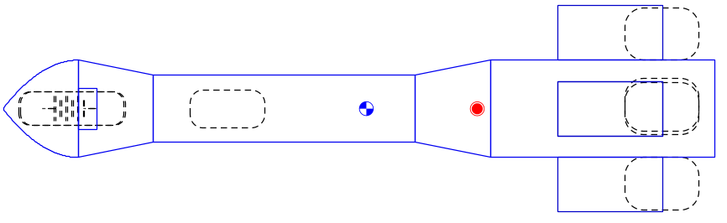
Stability Simulation (OpenRocket)
The farther the center of gravity (CG) is from the center of pressure (CP), the greater the stability of the rocket [4].
For rocket stability the CG should be located in an upper position than the CP position [5].
Empirical evidence and mathematical models suggest that the CP should be at least one body diameter behind the CG [5].
Notes:
Design results at a system level:-
The lander utilizes 4 fixed high-power brushless EDF motors for propulsion, with independent aerodynamic control fins positioned in the exhaust stream to provide thrust vectoring authority. This builds redundancy into the thrust system, while maintaining a simple & robust motor design without gimbal complexity. Fins use separate fast-response servo mechanisms with dedicated IMU feedback for tight closed-loop control.

Slide 36
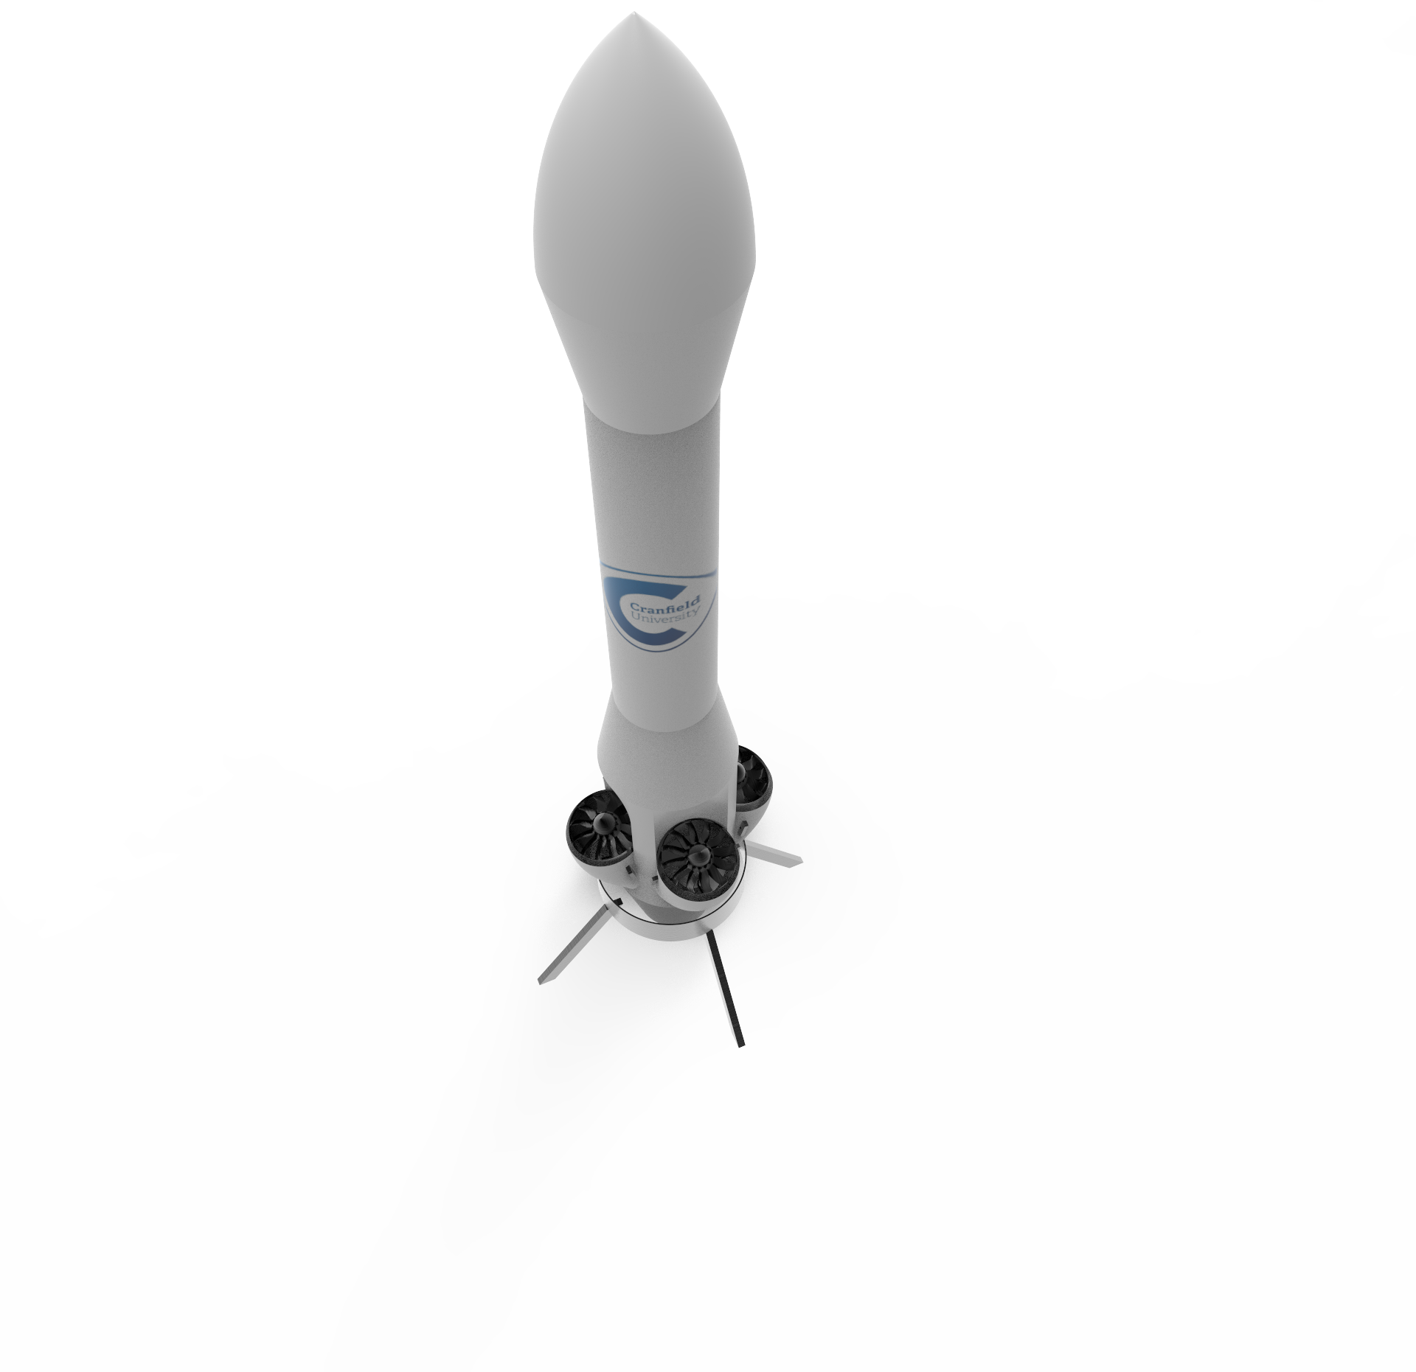
Design (CATIA)
Aerodynamic Shape
EDFs soft coupling
Components Adjustment

Slide 37
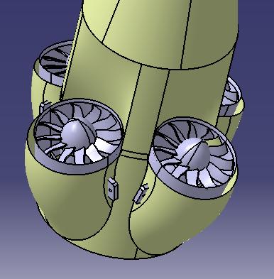
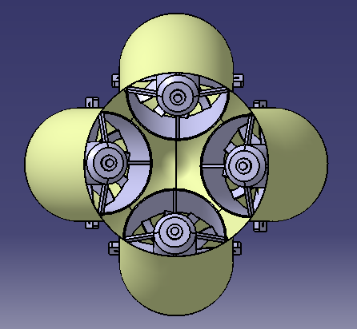
Engine Inclination
EDFs inclination is 15 deg
Losses because of the inclination will be around 3.5 %
Achieving the smallest rocket body diameter and pumping air into the

Slide 38
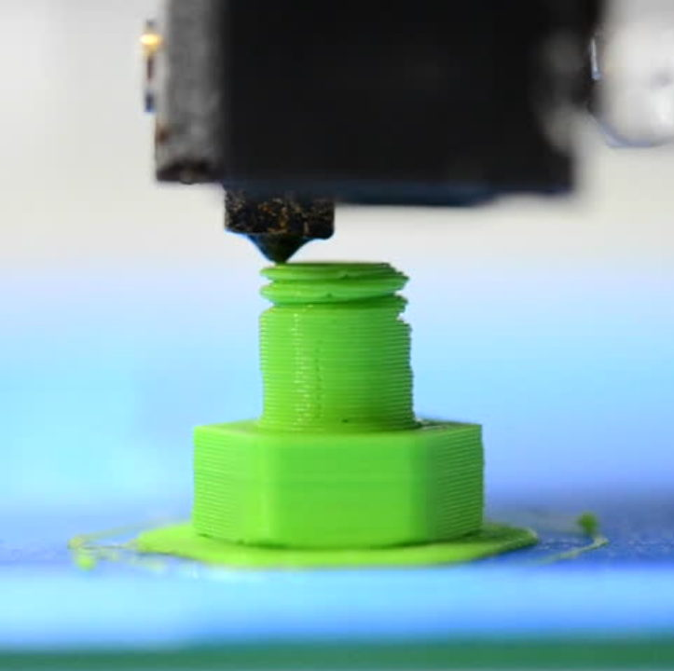
Structure Material
Light wight
Easy to Manufacture and Modify
Good Resistance

Slide 39
Trade off
 | Carbon Fiber | ABS
Density | 1.7 g/cm^3 | 1.05 g/cm^3
Fabrication | Difficult | Easy
Strength ( Fracture Toughness ) | High 6MPa. m^1/2 | Good 2MPa. m^1/2
Cost | High | Low

Slide 40
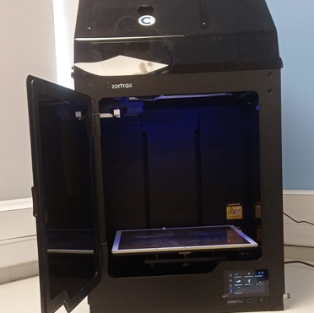
3D Printing
Zortrax m300 plus
Build Volume
300mmx300mmx300mm
Different infill Level
Design separation due to 3D printer dimensions and easy access to the internal components. (screws)

Slide 41
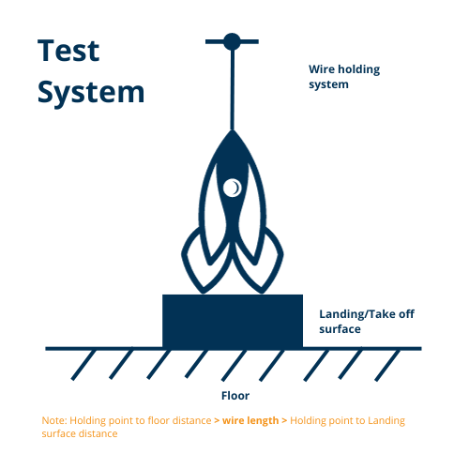
Fail-Safe
Wire System for Higher Landing Spot System for testing stages
Notes:
Sebastien

Slide 42
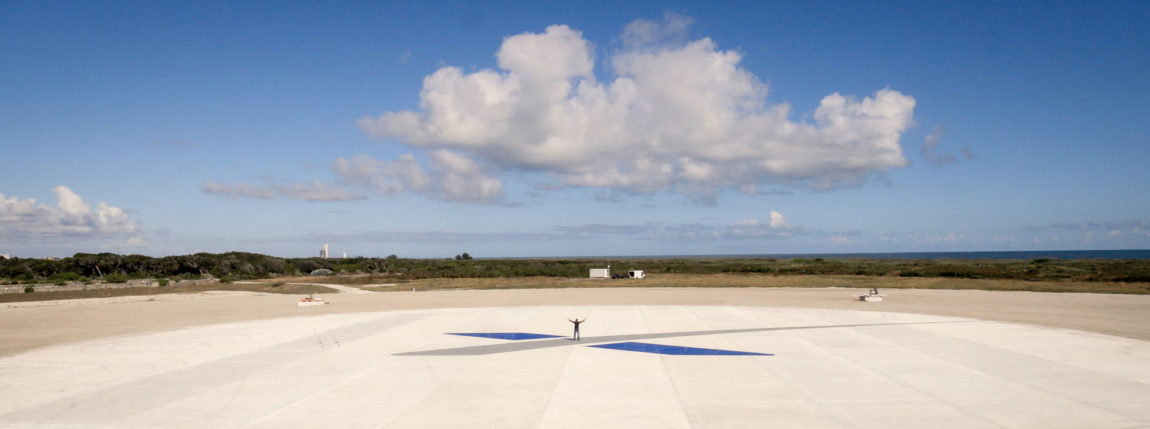
Landing zone
SpaceX photos –Landing Zone1
The prototype shall land on a landing pad:
2150% larger than his diameter so 325cm ⌀ for 15 cm ⌀ (LZ1 scale)
Then an 833% by 2500% of the diameter so 124.5x375cm (Of Course I Still Love You scale)
Then a 60x60 cm ( 4 times larger ~ logo scale )

Slide 43
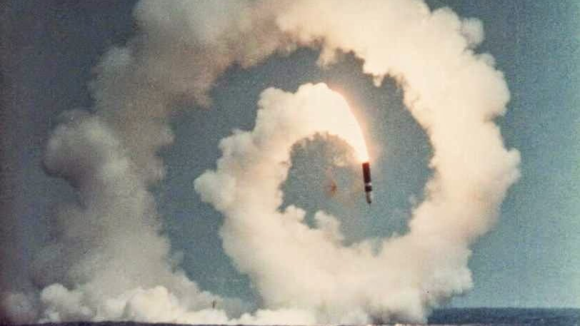
Team Control
Cette photo par Auteur inconnu est soumise à la licence CC BY-SA-NC

Slide 44

Sensors
Give the position of the rocket
1
Detect the landing spot
2
Help to land
3
-IMU
-Camera
-LIDAR
-Positioning System
-Camera
-ToF Camera
-Camera
-LIDAR

Slide 45
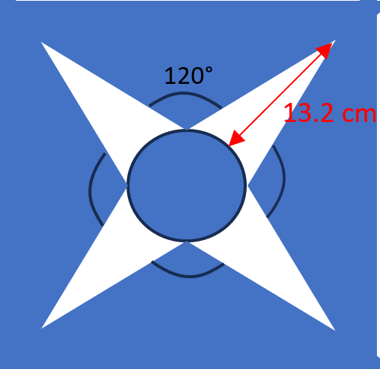
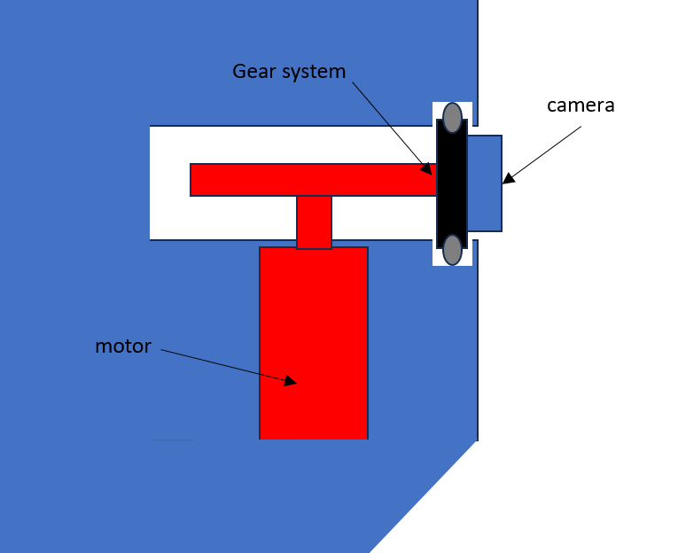

First design attempts
- blind spot
-use too much computational power
-Too complicated

Slide 46
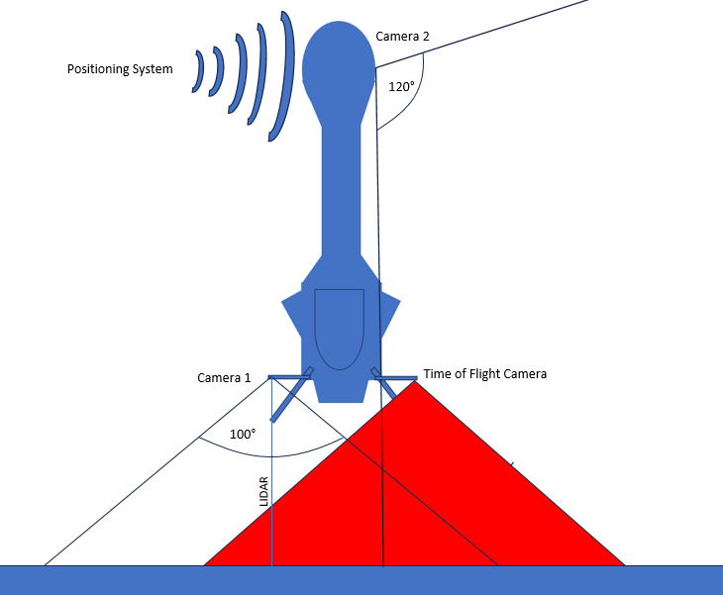
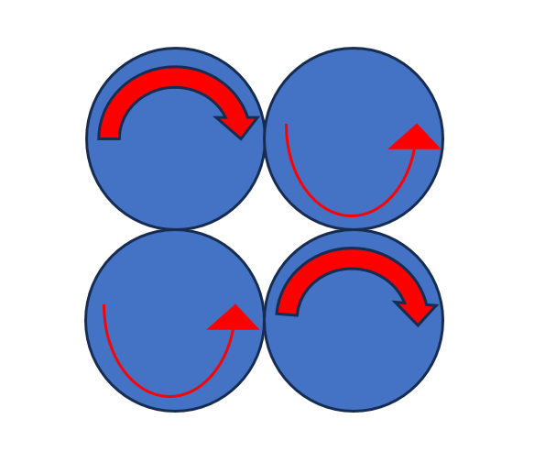
Chosen design
1 1D LIDAR
2 Cameras
1 IMU
1 ToF Camera
Positioning System
Reminder:

Slide 47
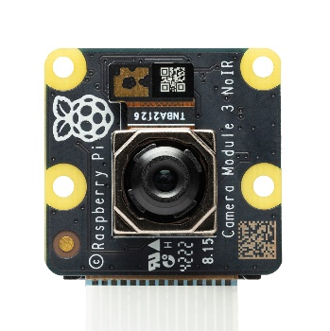
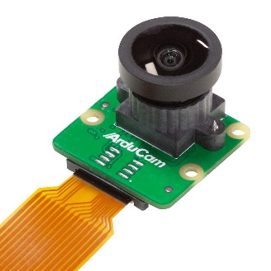
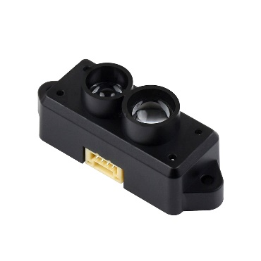
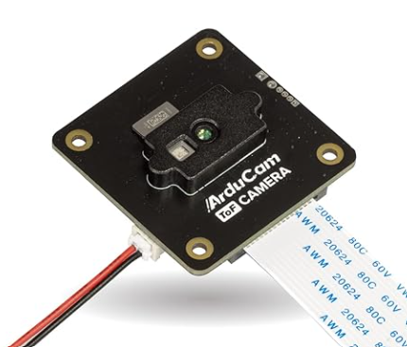
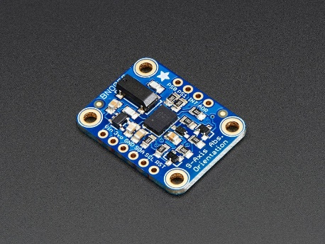
Final Components
IMU
Camera 1
Camera 2
Lidar
ToF Camera
Adafruit IMU BNO055
- 9 DOF
- 100 HZ
-used a lot
Raspberry Pi Camera Module 3 NoIR wide
-cheaper
-used a lot
Arducam 12MP IMX708 HDR 120°
-angle of view:
120(H)/66.7(V)
TF-Luna Lidar Ranging Senso
- distance 8m
-precision 6 cm
- FOV 2°
Arducam ToF Camera
- cheaper
- 120 fps
-compatible to Rpi
- FOV 70°D
3g 5g 9g 5g 5g
34.50£ 26£ 34.70£ 23.40£ 50£
Total Weight: 27g Total Price: 168.6£

Slide 48
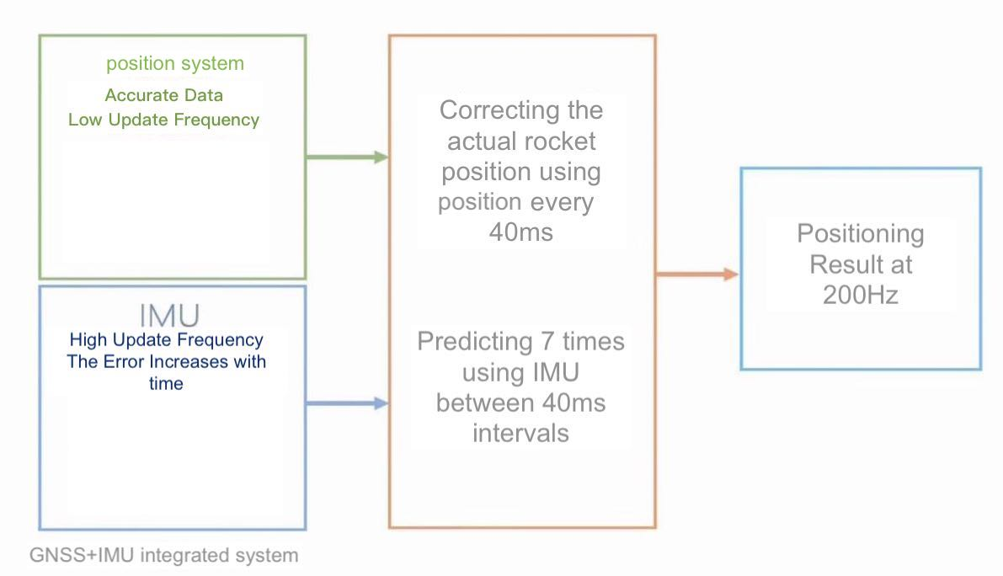
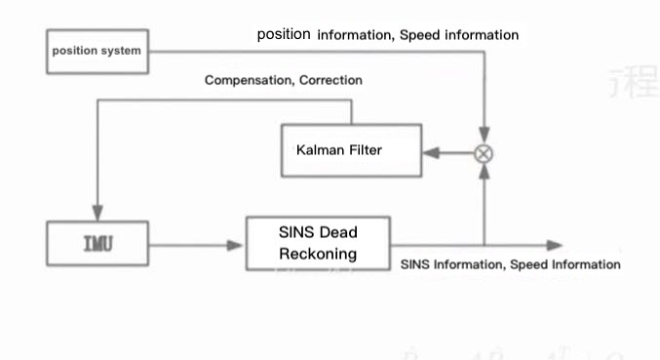
Flowchart and Schematic diagram of sensor fusion

Slide 49
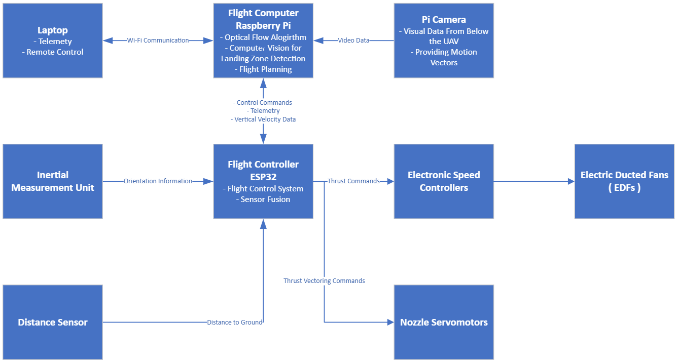
Control System Architecture

Slide 50

Modeling & Simulation

Slide 51
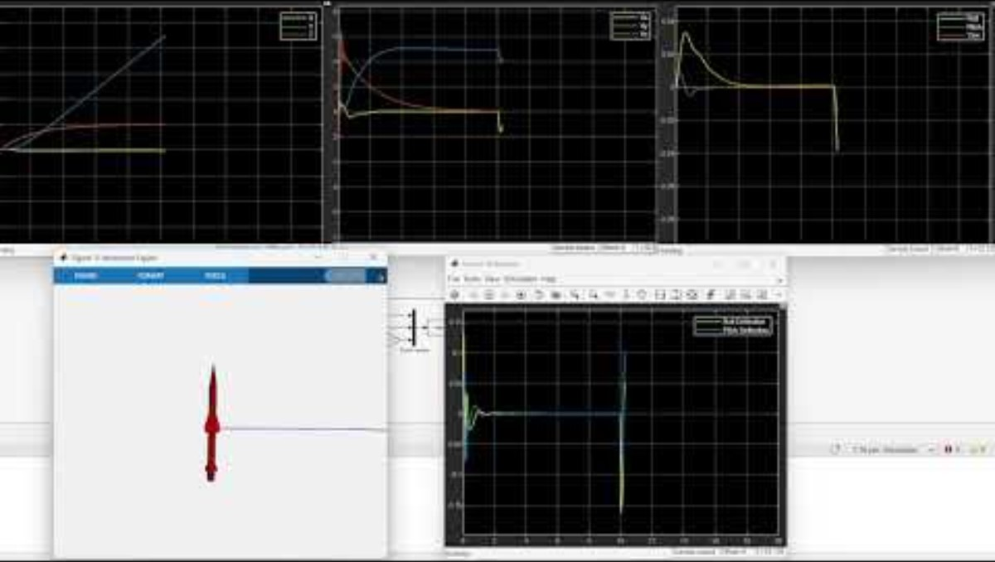
Modeling & Simulation

Slide 52
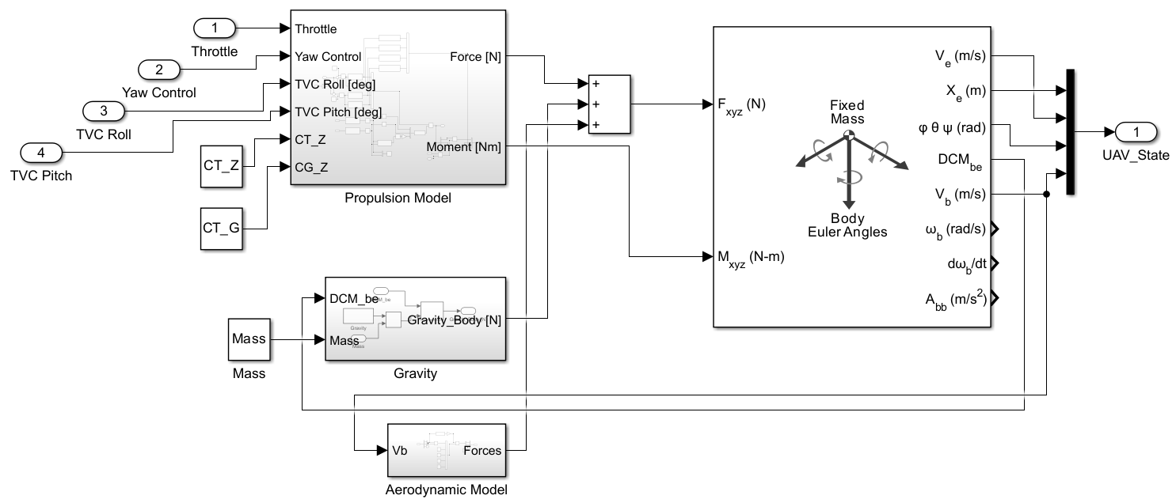
Modeling & Simulation – UAV Model
Propulsion Model
Gravity
Basic Aerodynamic Model
6DOF (Aerospace Blockset)

Slide 53
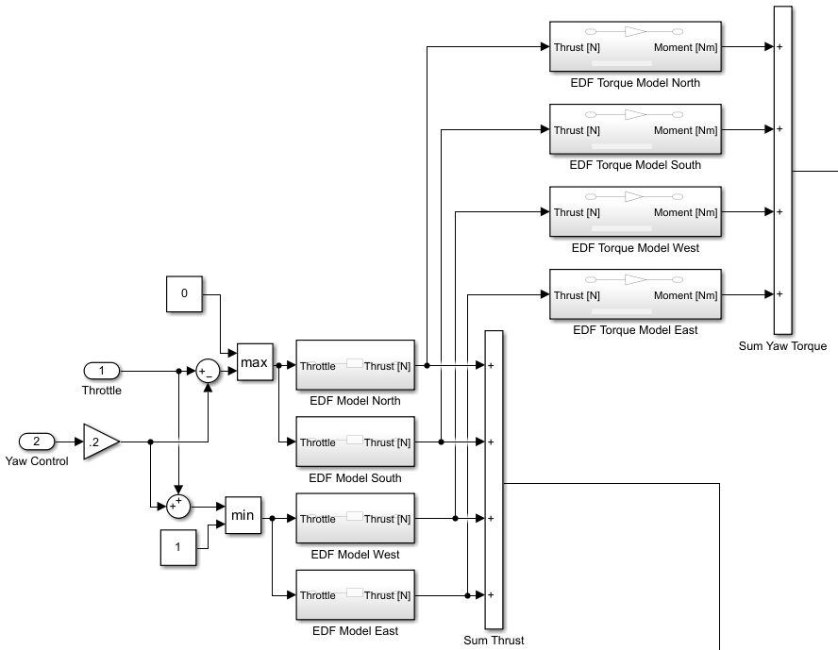
Modeling & Simulation – Propulsion Model (1 / 2)
Fully adjustable by modifying transfer functions: Throttle to Thrust Thrust to Torque
Yaw Control by thrust and therefore moment difference between CW and CCW EDFs like it is performed in quadcopters [1]

Slide 54
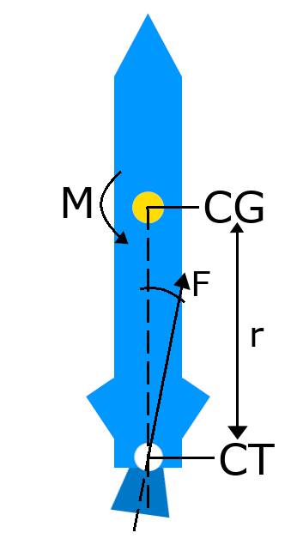
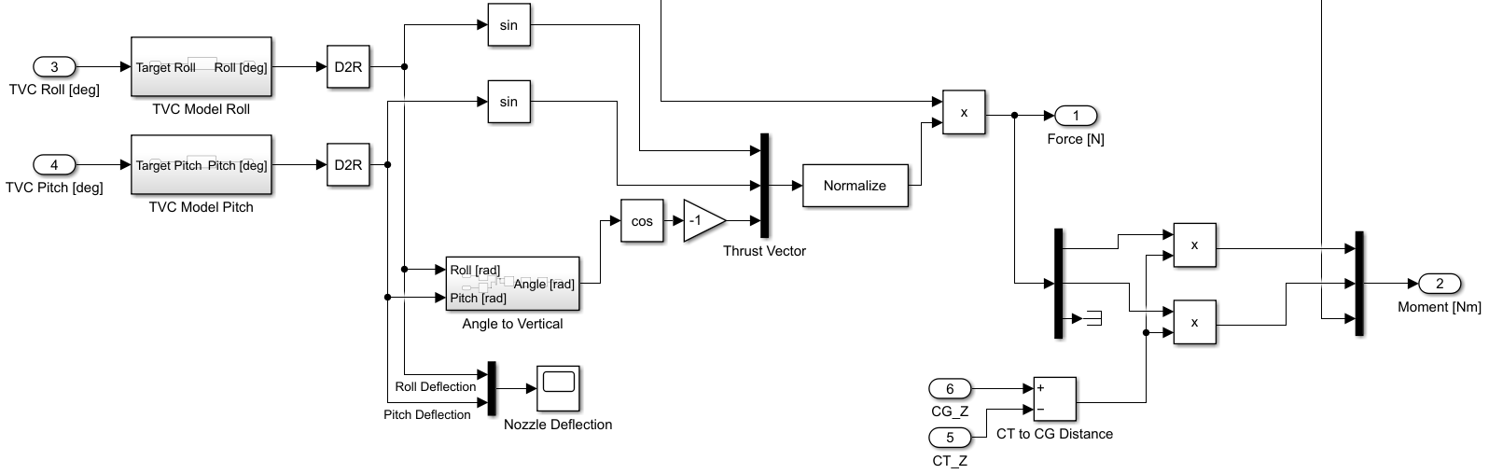
Modeling & Simulation – Propulsion Model (2 / 2)
Thrust Vectoring Model
M = F * r

Slide 55


Modeling & Simulation – Gravity & Aerodynamics

Slide 56

Modeling & Simulation – Autopilot
Altitude Hold
Yaw Control
Horizontal Velocity Control Relative to Heading of The UAV

Slide 57

Modeling & Simulation – Controller Based on PIDs
Low computational power usage
Simplicity
Powerful and commonly used across different types of applications in industry
Well studied
[1]

Slide 58


Modeling & Simulation – Sensor Simulation
Simulation of real sensor behavior based on state of the UAV in simulation and noise: IMU, Ground Distance and Horizontal Velocity

Slide 59


Control components
Raspberry pi
ESP 32
Notes:
The raspberry pi is always going to be connected to the external positioning system for safety purposes

Slide 60

Activity plan
Notes:
Verification plan
Design: Separation of the structure design for 3D printing, parts clearance holes design for screw joining, linking mechanisms for the components, camera holder pointing downwards and nacelle-servo mechanism.

Slide 61


Slide 62

Kanban

Slide 63

Annex

Slide 64
4 EDF
1 EDF
Specs:
4 EDF motors, peak power is 4 * 1764W = 7056W
60% Throttle Cruise Power: = 0.60 * 7056W = 4234W
Using 2 x 5000mAh 22.2V 6S batteries (8800W capacity total)
Thrust = 9.2Kg @ 100%, 5.52Kg @ 60% throttle
Analysis:
Battery energy capacity = 5000mAh x 22.2V x 2 = 222 Wh
Maximum discharge rate = 80C = 80 x 5A = 400A
Maximum battery power = Current x Voltage = 400A x 22.2V = 8880W
Flight Time Estimate:
Total energy capacity = 2 x 5000mAh x 22.2V = 222Wh
Power consumption @ 60% throttle = 4234W
222Wh / 4234W = 0.0525 hours
= 3 minutes 15 seconds flight time
Specs:
EDF Motor: 590Kv
Peak Power Draw by EDF: 4460W
80% Throttle Cruise Power: 0.80 * 4460W = 3568W
Thrust = 7.5Kg @ 100%, 6Kg @ 80% throttle
Battery specs:
6S2P = 2 x (6 cells series) in parallel
6S 4500mAh 35C LiPo x 2
Typical LiPo cell voltage = 3.7V
Total voltage = 12 * 3.7V = 44.4V
Capacity = 4500mAh
Flight Time Estimate:
Total energy capacity = 4500mAh x 44.4V = 200 Wh
Power at 80% = 3568W
Flight Time = Energy / Power = 200Wh / 3568W = 0.056 hours
= 3 minutes 21 seconds flight time

Slide 65
Components Links
Links | EDF(CCW) :- https://www.turbines-rc.com/en/turbines-rc-fd/3228-edf-ducted-fan-fd-model-pro-70mm-12-blades-6s-motor-2100kv-ccw.html EDF(CW) :- https://www.turbines-rc.com/en/turbines-rc-fd/3227-edf-ducted-fan-fd-model-pro-70mm-12-blades-6s-motor-2100kv-cw.html ESC : https://www.hyperflight.co.uk/products.asp?code=BE390&name=e-power-plus-90a-high-rpm-esc | EDF :- https://www.turbines-rc.com/en/ejets-jetfan/1370-ducted-fan-edf-jetfan-120-pro-ejets-het-800-73-590.html ESC : - https://www.turbines-rc.com/en/50a-and-over/869-het-zeus-150a-hv-esc-6-12s-opto.html
Price | Total : - £239 + £302 + £176 + £15 = £750 with connectors | Total : - £419 + £120 + £163 + £15 = £735 with connectors

Slide 66
References
[1] Song, Zhengyu, and Cong Wang. "Powered soft landing guidance method for launchers with non-cluster configured engines." Acta Astronautica 189 (2021): 379-390.
[2] Ang, Kiam Heong, Gregory Chong, and Yun Li. "PID control system analysis, design, and technology." IEEE transactions on control systems technology 13, no. 4 (2005): 559-576.
[3] Luukkonen, Teppo. "Modelling and control of quadcopter." Independent research project in applied mathematics, Espoo 22, no. 22 (2011).
[4] R.V. Nanditta, “Structural Design and Analysis of High-Powered Model Rockets.” Accessed: Jan. 11, 2024. [Online]. Available: https://www.researchgate.net/publication/351516091_Structural_Design_and_Analysis_of_High-Powered_Model_Rockets
[5] F. S. Azevedo, “Knowing the Stability of Model Rockets: A Study of Learning in Interest-Based Practices,” Cogn. Instr., vol. 31, no. 3, pp. 345–374, Jul. 2013, doi: 10.1080/07370008.2013.799168.
[6] J. M. J. C. H. M. LUKE SALA, "Orion Aerospace," 2020. [Online]. Available: https://www.youtube.com/watch?v=UfoYZlLNC90. [Accessed 11 01 2024].
[7] T. S. M. S. m. Mariusz Chmielewski, "Iwis.polskiewynalazki.pl," 25 08 2021. [Online]. Available: https://www.youtube.com/watch?v=cDIzuPaOlDM. [Accessed 11 01 2024].

